Slide 1

Producing Green Hydrogen from Waste Metal Scrap

Slide 2

Introduction to Hydrogen Production
Hydrogen is a promising alternative fuel with high energy potential, mainly produced from carbonaceous fuels for fertilizer and petroleum industries.
Fossil fuel production is expected to peak by 2025, making sustainable hydrogen production methods, such as water splitting using solar energy, increasingly important.
Innovative approaches like using industrial waste metal scrap for high-temperature water splitting provide eco-friendly solutions for the future hydrogen economy.

Slide 3
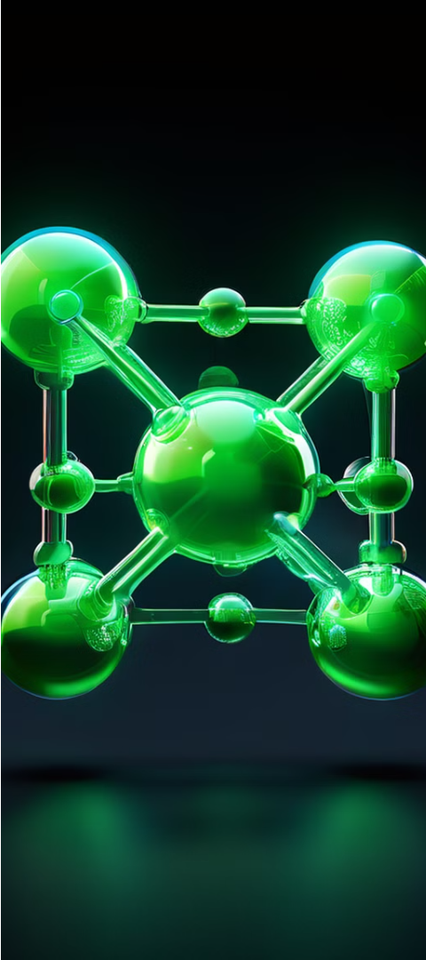
Goal
To revolutionize clean energy production with innovative green hydrogen solutions.

Slide 4

Innovative Pathways to Green Hydrogen: The Process Unveiled
Collection and Preparation of Scrap Metal
Cleaning and Contaminant Removal
Characterization and Analysis
Industrial mild steel waste-metal scrap is collected from machine shops.
Scrap metal is cleaned with detergent and water to remove oils and contaminants.
The X-ray diffraction (XRD) patterns of the mild steel scrap materials are recorded using a Bruker D8 Advance.
The scrap materials, of various particle sizes and shapes, are processed to fit reactor conditions.
The cleaned samples are sonicated in acetone for 15 minutes and then dried in a hot air oven.
This characterization is essential for understanding the properties of the metal before the water splitting experiments.

Slide 5
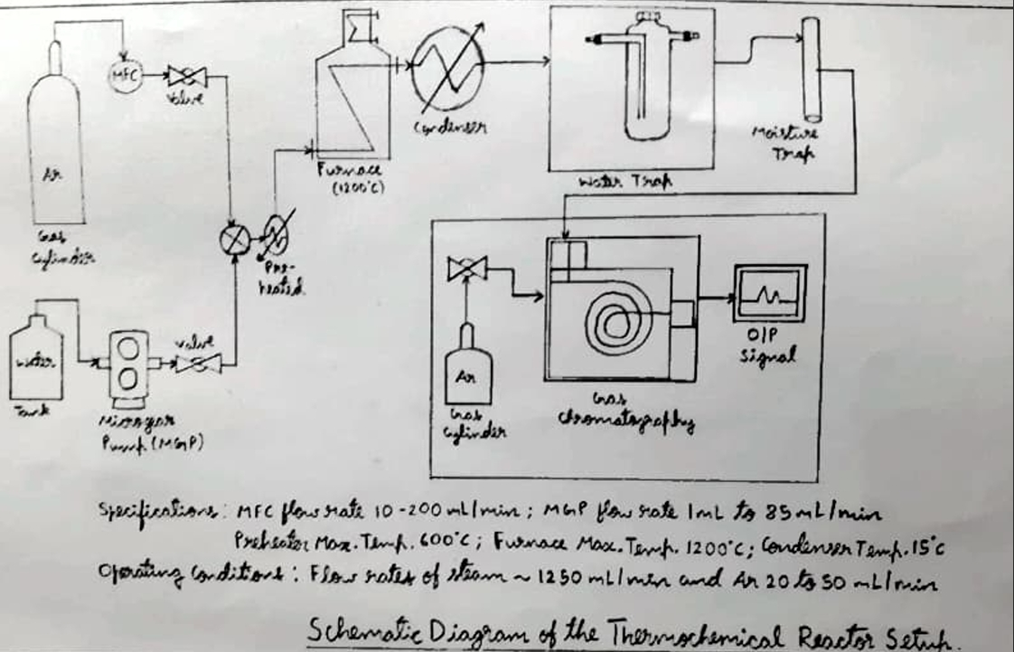

Slide 6

High-Temperature Heating and Steam Exposure
Hydrogen Generation and Reaction Control
Gas Collection and Analysis
As steam moves through the hot metal scrap, water molecules split and oxidize the metal atoms, producing hydrogen.
The exit gas, which includes unreacted steam, carrier gas, and hydrogen, is passed through a condenser and a moisture trap.
Cleaned metal scrap is loaded into a packed-bed reactor and heated to high temperatures (about 1150°C).
Steam, generated by a pre-heater at 600°C, is passed over the hot metal scrap bed.
A PID controller is used to regulate the temperature of the furnace for controlled experiments.
The hydrogen and carrier gas mixture is analyzed using an online gas chromatograph to ensure quality and purity.

Slide 7
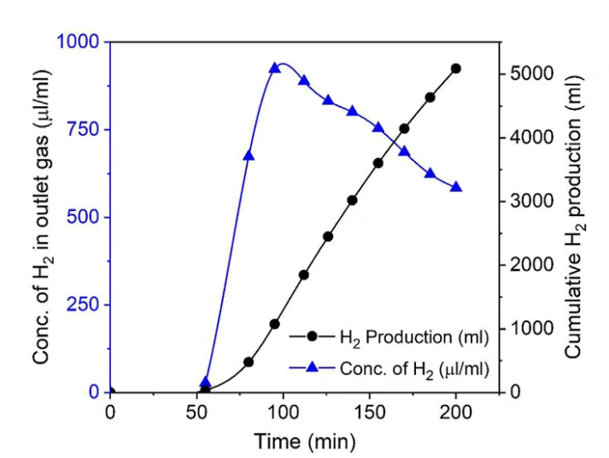

Chemical Reactions and Conversion.
The raw mild steel scrap, primarily containing iron, is loaded into the thermochemical reactor. Upon exposure to steam at 1150°C, the iron oxidizes to form iron oxide (Fe3O4), releasing hydrogen.
The concentration of hydrogen gas at the reactor outlet and the cumulative production of hydrogen gas is plotted as a function of collection time in. The release of hydrogen gas is noted from the thermochemical reactor after the in duction period of about 50 min, which is quantitatively measured using an online gas chromatograph

Slide 8

Data Insights
Availability of Scrap Metal
Production Rate
India generates around 27-30 million tonnes of scrap metal annually.
5 Lakh liters of Hydrogen from 1 Tonne of metal only.
Conversion Efficiency
Impressive Efficiency of approximately 94%.

Slide 9
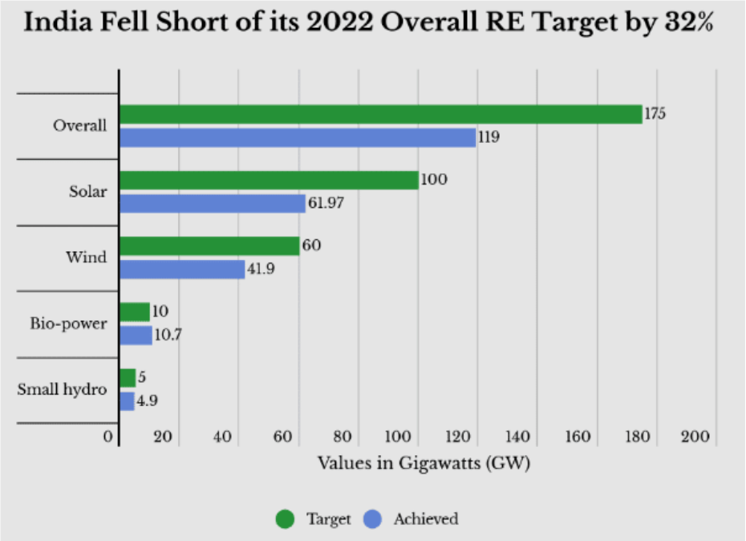

Slide 10
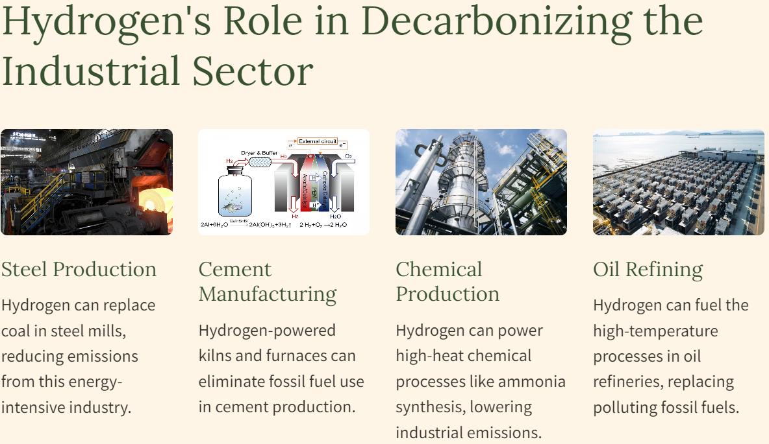

Slide 11

Competitors
Industry Chemicals and Medical Production
Founded
2012 in Red Wood City , United States
Products
Carbon black Anhydrous Ammonia Hydrogen
Founders Robert Hanson
Pete Johnson

Slide 12

Notes:
• That's the end of the presentation. Now we'll open it up to any questions you may have. • I'm happy to take any questions you might have about the topics we've covered. Please feel free to ask anything that's on your mind. • We've covered a lot of ground, so I'm sure you may have some lingering questions. I'm here to address any concerns or clarify anything that's still unclear. • The floor is now open. Please raise your hand if you have a question, and I'll be glad to respond. • Let's use this time to have an open discussion and address any outstanding issues or topics you'd like to explore further.

